Slide 1


Direct numerical simulation of a hypersonic boundary layer with porous wall injection
Ralf Deiterding, Adriano Cerminara,
Neil Sandham
Department of Aerospace Engineering, University of Southampton
17/11/2020

Slide 2
Contents
Introduction
Numerical method
General setup and solver verification & validation
Flat plate with slot injection
Flat plate with injection through porous material
Conclusions
Part of EPSRC Programme Grant Transpiration Cooling Systems for Jet Engine Turbines and Hypersonic Flight http://transpirationcooling.eng.ox.ac.uk
2

Slide 3
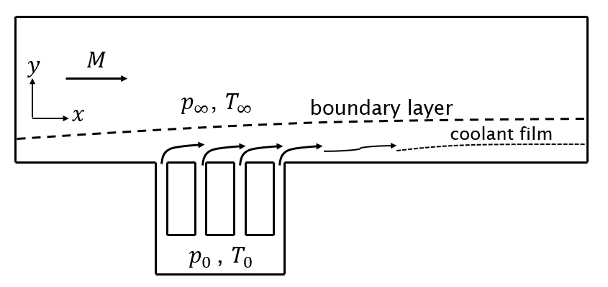
Film cooling
Formation of a thin film of cold fluid adjacent to the wall
Wall heat flux reduction achieved by a dual effect:
Reduction of the local fluid temperature near the wall
Reduction of wall temperature gradient due to BL thickening
Film cooling (Fitt et al., 1985, 1994): effusion cooling vs transpiration cooling
Effusion cooling (Wittig et al. 1996, Baldauf et al. 2001): coolant injected by localized holes
  3D effects induced in the BL, which promote transition
  Typically used on gas-turbine blades (turbulent BL)
Transpiration cooling (Meinert et al. 2001, Langener et al. 2011): fluid injected through a porous material
  More homogeneous injection
  Higher effectiveness
3

Slide 4
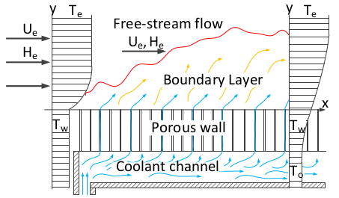
Purpose of direct numerical simulation
Understand the physics of blowing in hypersonic flow through porous surfaces
Predict cooling performance – heat transfer rates
Estimate the effects on BL stability and transition
Validate results with experiments
4

Slide 5



Numerical method for full Navier-Stokes equations
Finite volume approach in a Cartesian reference system with embedded boundaries
Structured-adaptive-mesh-refinement (SAMR) algorithm (AMROC - Deiterding, 2005 & 2011): the Cartesian grid is locally refined by adding consecutive finer grid levels during the iteration cycles (patch-wise refinement strategy)
Hybrid WENO-CD method up to 6th -order accurate for both inviscid and viscous fluxes (Cerminara, Deiterding, Sandham, 2018)
Central Differencing (CD) scheme used in the smooth regions:
E.g. for 6th -order, the numerical flux at the interfaces is evaluated as
3rd –order Runge-Kutta for time integration
Characteristic-based switch to a high-resolution WENO scheme to handle discontinuities in a computationally efficient way (Hill and Pullin, 2004)
5

Slide 6



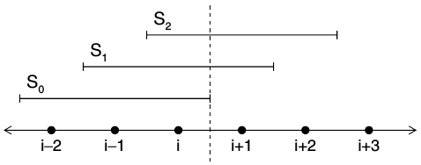


Shock-capturing scheme
Weighted-essentialy-non-oscillatory - symmetric - order-optimized (WENO-SYMOO) scheme (Martin et al. 2006)
Reduced dissipation (compared to 5th-order WENO-JS, Jiang and Shu 1996), and 6th maximum formal order of accuracy, reached through:
  Symmetrization: a fourth candidate stencil is added to the initial (r=3)-points upwinded-biased candidate stencils of the WENO-JS
  Optimal weights C_{k} to guarantee 6th-order accuracy
r-th-order polynomial interpolation on the k-th stencil
weight of the k-th interp.
from Martin et al. 2006
smoothness indicator
6

Slide 7




Scheme switch
Riemann problem is solved at each cell interface through Roe's averaged state
Lax condition is applied to detect shock/rarefaction waves
A threshold is applied to the residuals between the left/right state and the intermediate state to select the strong waves and neglect the weak ones (Ziegler et al., 2011)
Another threshold is applied to the function to allow WENO only in the high pressure-gradient regions (Ziegler et al., 2011):
7

Slide 8
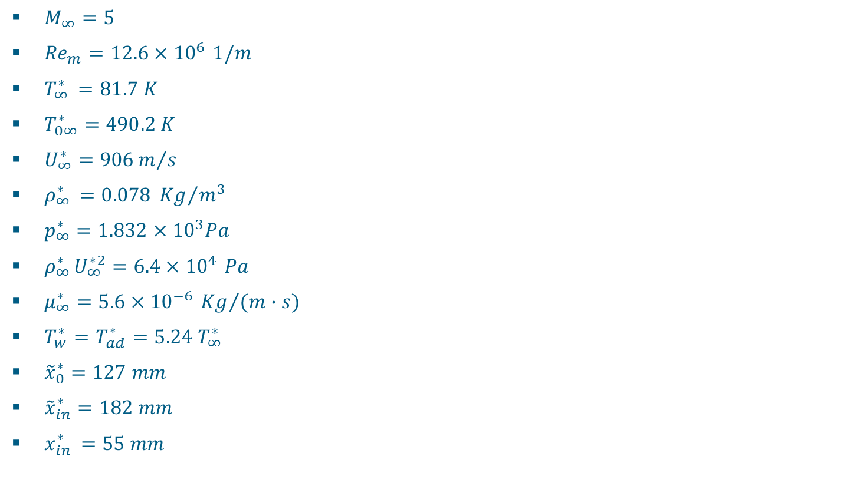
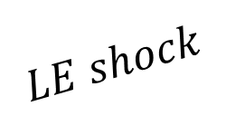









Flat plate studies:
Flow conditions and domain set-up
8

Slide 9
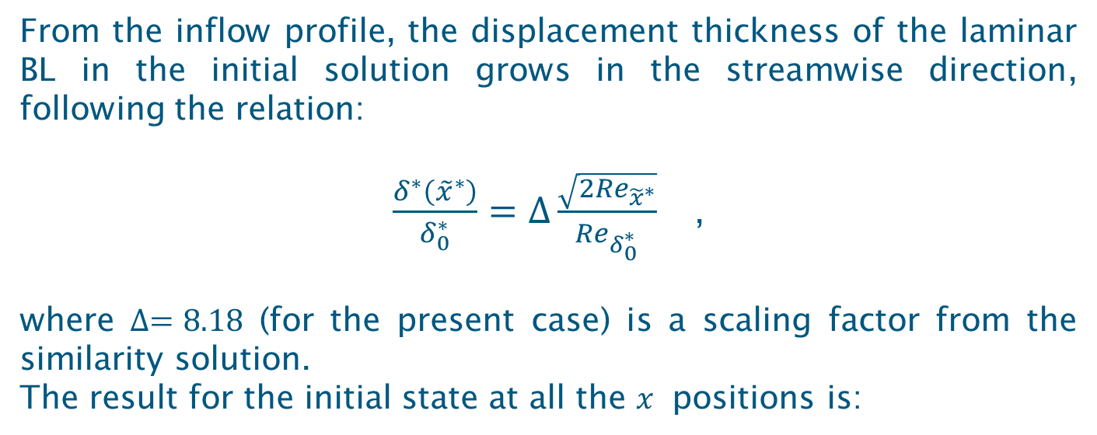
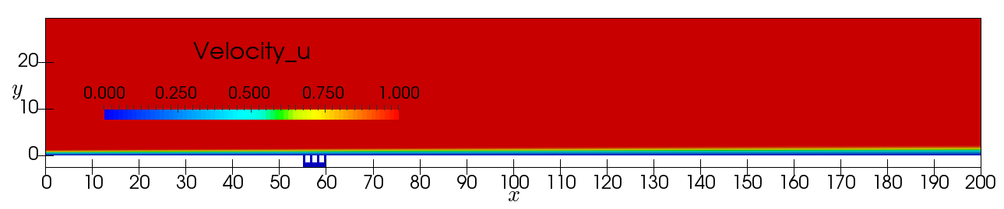
Initialization
9
9

Slide 10
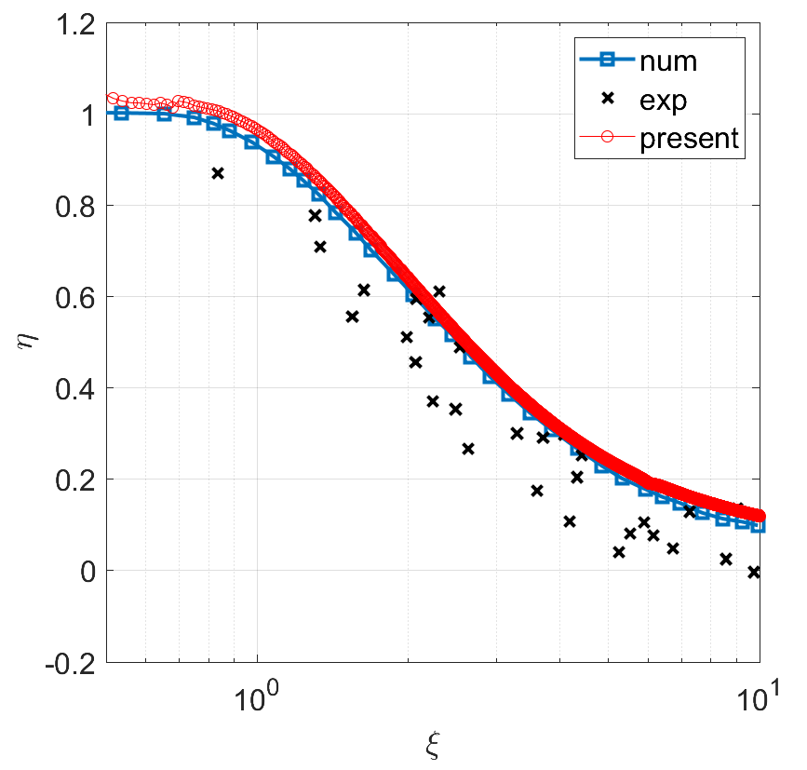
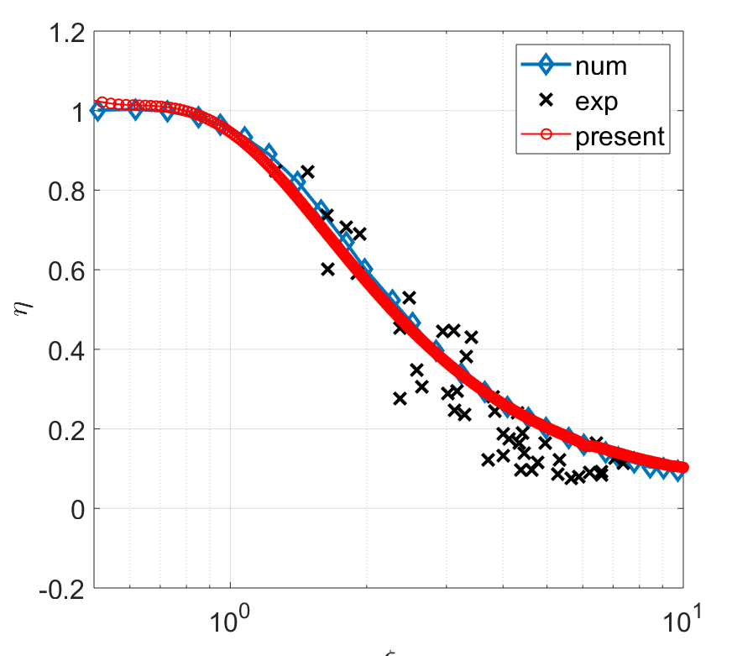

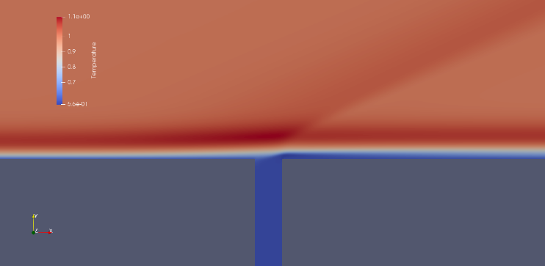
Validation case: slot injection with multi- component gas effects
Air injection
CO₂ injection
T
Very good agreement with Keller et al. (2015) results of cooling effectiveness in a Mach 2.6 case
10

Slide 11
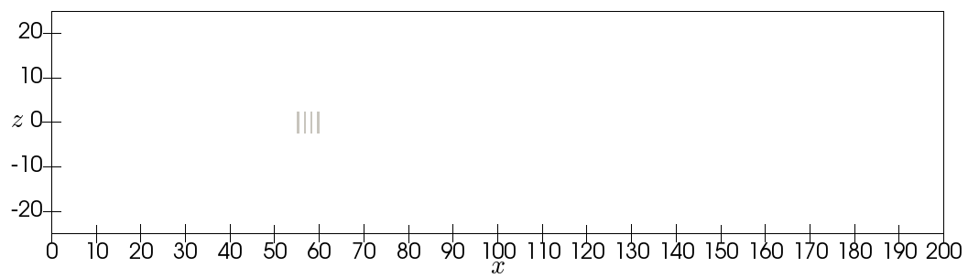
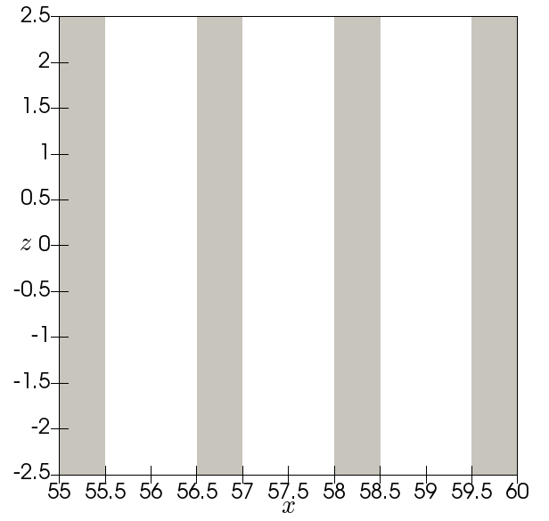


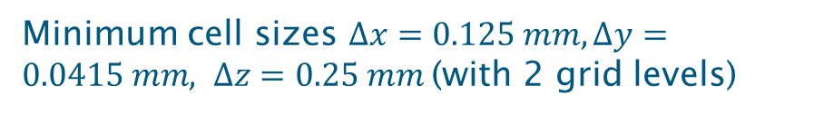
3D flat plate with blowing through finite slots
Simulation run with 480 cores on Iridis 4 cluster (Soton HPC facility)
11

Slide 12

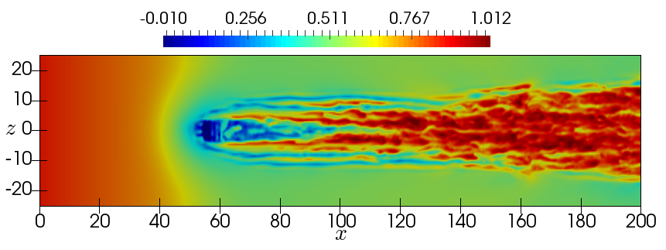


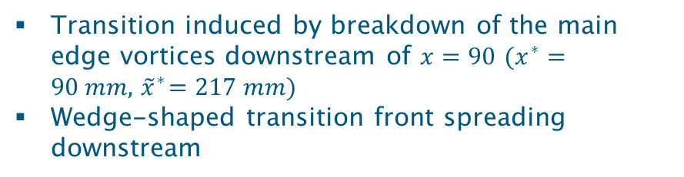
3D flat plate with blowing through slots
Horseshoe vortices
(low-velocity streaks)
wake
Edge vortices (high-velocity streaks)
12

Slide 13
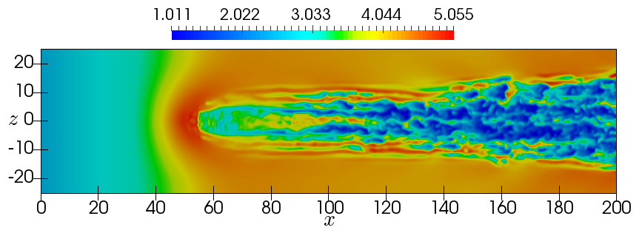

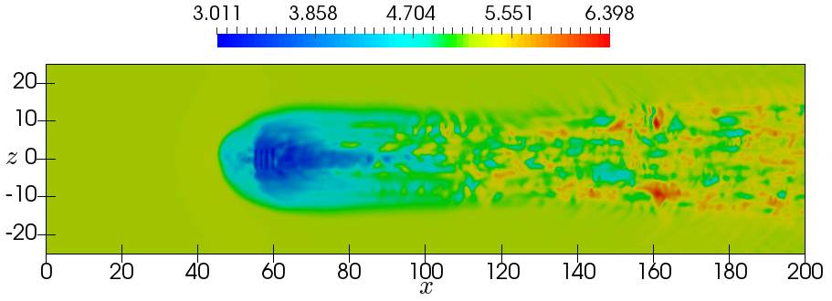

3D flat plate with blowing through slots
Cooling performed mainly at the slot sides and along the wake
Limited streamwise extent of the cooled region due to transition to turbulence
13

Slide 14
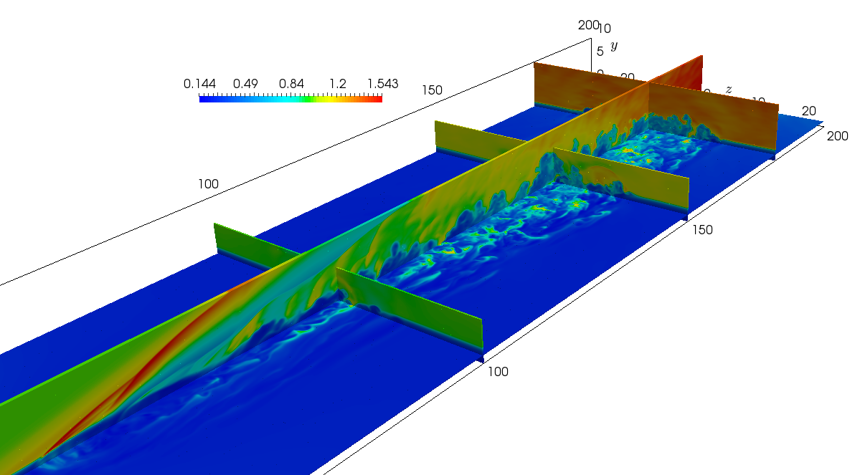
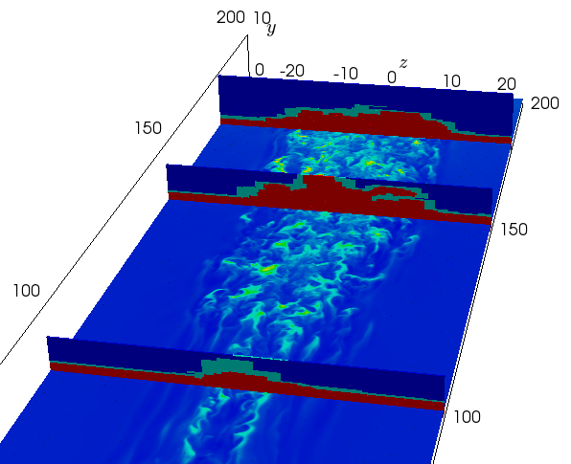
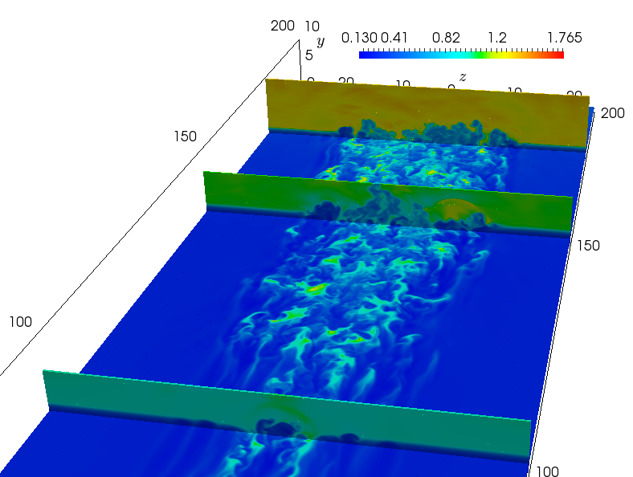
3D results
Right, bottom right: density field
Left, bottom: AMR levels
14

Slide 15




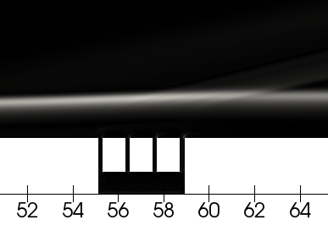
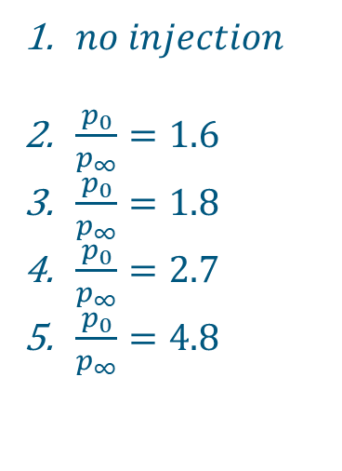


Oxford slot experiments
Characteristic length = 1 mm (BL displacement thickness at inflow)
Periodic b.c.
Top view
extrapolation b.c.
outflow b.c.
Periodic b.c.
Injection conditions:
15

Slide 16
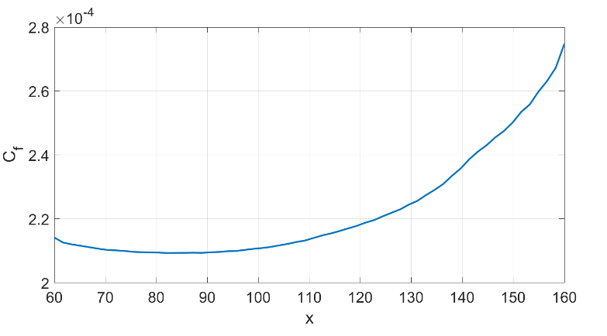
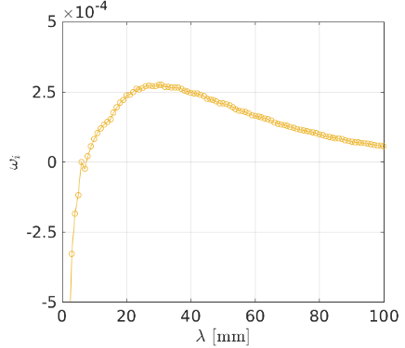


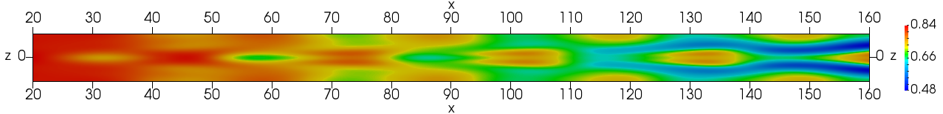

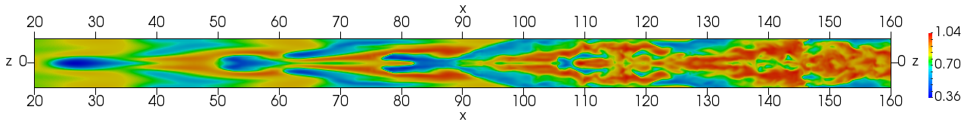
Transitional flow state
LST to identify the most unstable frequencies and wavenumbers
Model to reproduce instability modes
Most unstable mode: α=0.2, β=0.78
Low A – imprint of growing instability
High A
16

Slide 17
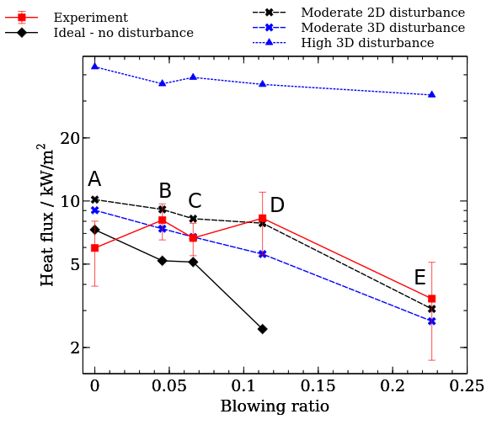
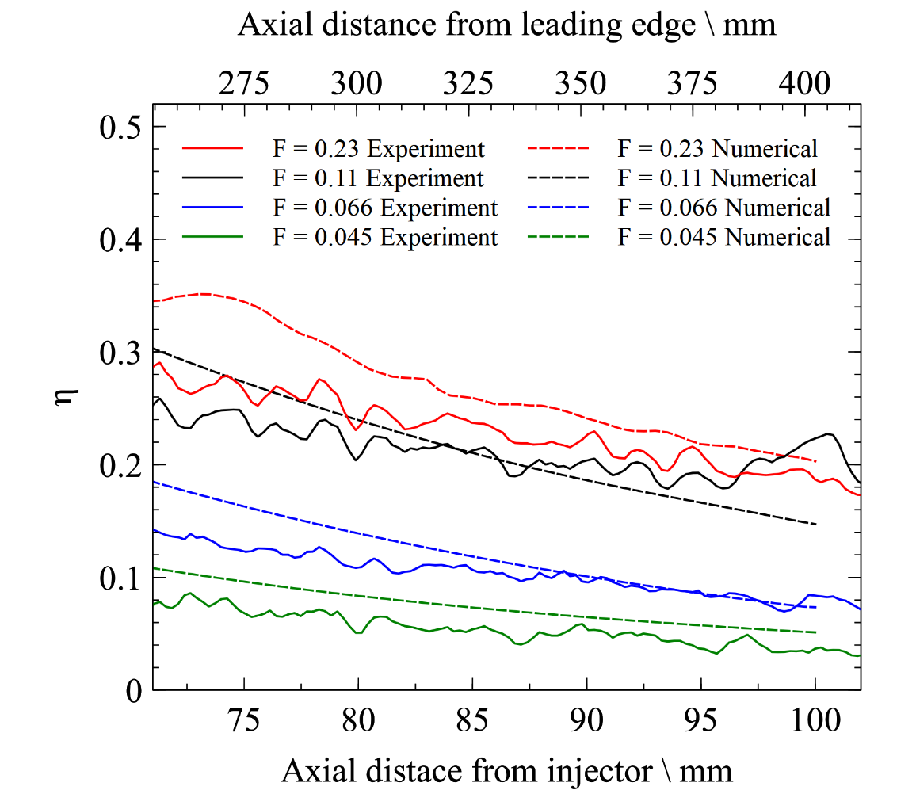
Heat flux and effectiveness predictions
Effectiveness measure based on concentration
Heat flux
(Cerminara et al., Aerospace Science Technology, 2020)
17

Slide 18
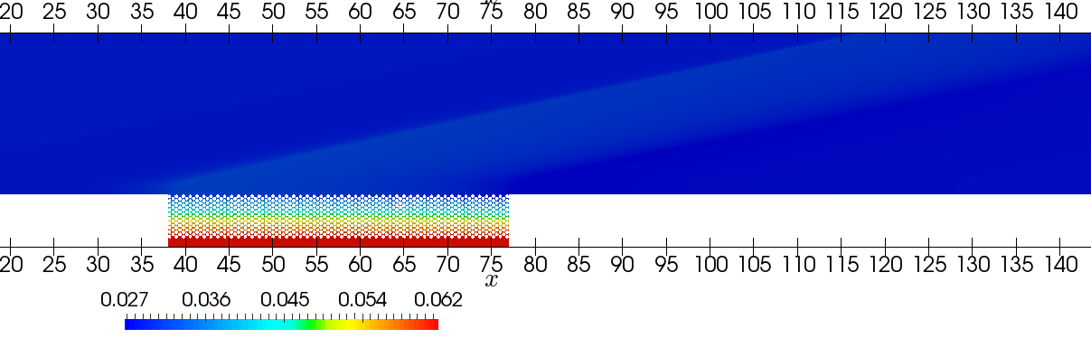
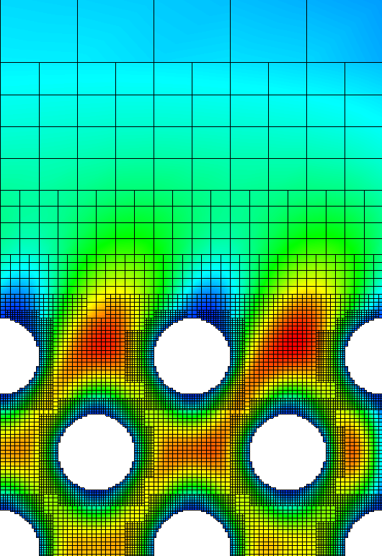
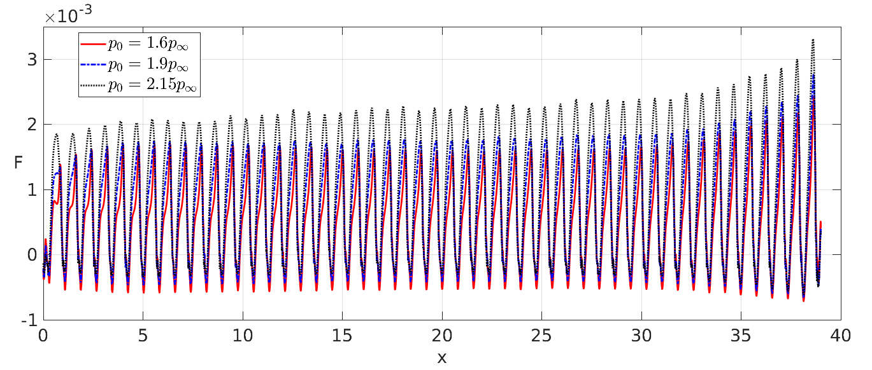
Modelling of porous material
Original project proposal assumed grain structures of >50μm
Used material has grains <2μm (cost of DNS in porous material increases by factor approx. 25⁴=390625)
Our approach: model the porous media flow using regular sphere/cylinder arrays of resolvable mesoscopic size
Cylinders with radius of 200μm, pressure contours
Blowing ratio at different plenum pressures
Automatic adaptive mesh (vertical velocity)
18

Slide 19
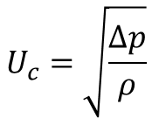



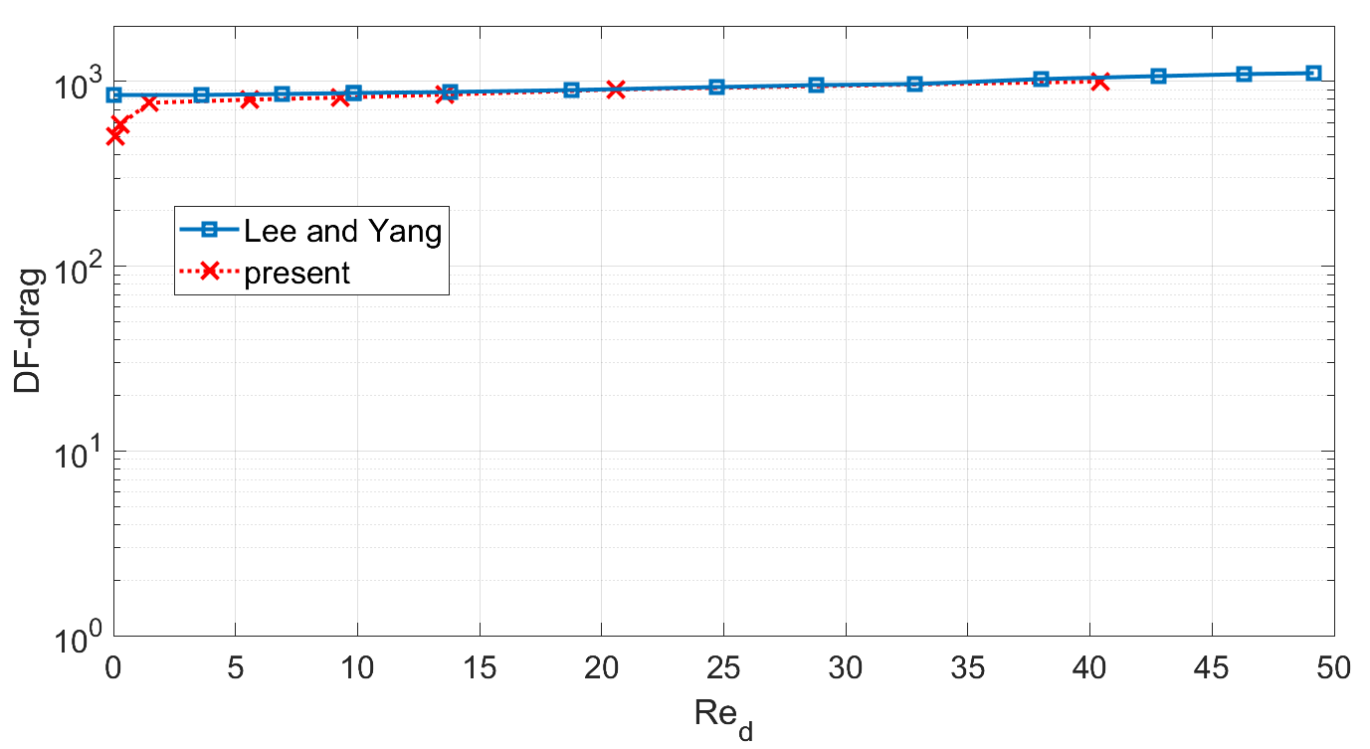
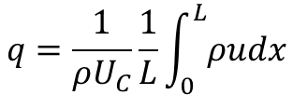
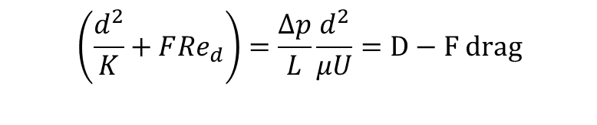
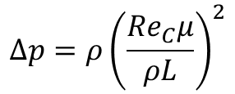
Mesoscopic Darcy-Forchheimer model
$$\left(\frac{d^{2}}{K}+F{Re}_{d}\right)=\frac{∆p}{L}\frac{d^{2}}{μU}=D−F drag$$
$$q=\frac{1}{ρU_{C}}\frac{1}{L}\int_{0}^{L}{ρudx}$$
$$∆p=ρ{\left(\frac{{Re}_{C}μ}{ρL}\right)}^{2}$$
Objective: represent the pressure drop of micro-structured material with larger cylinders
Idea is to vary d but maintain q
Preliminary study follows approach of Lee and Yang (1997)
19
Zoom in: y-momentum in porous layer for d=12μm

Slide 20
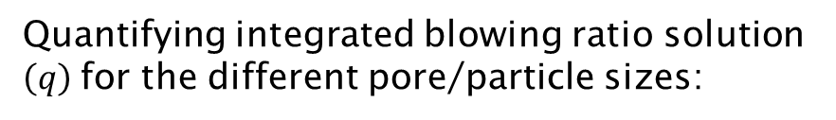

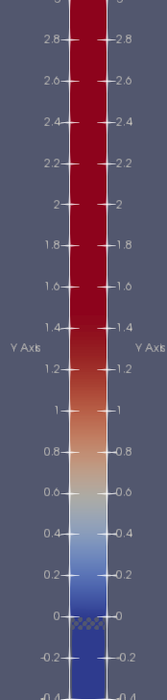
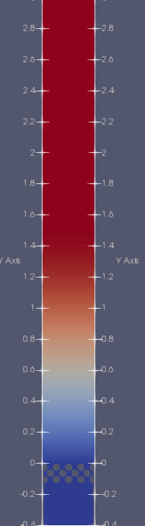
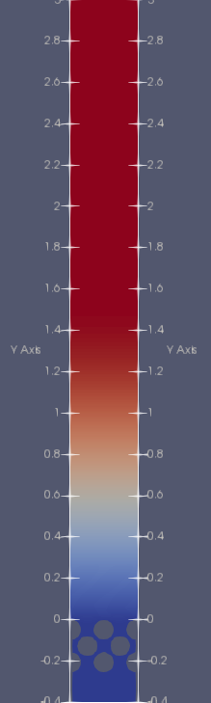
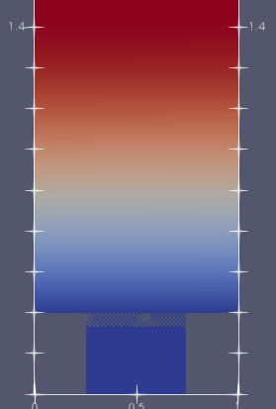




Matching with experiment in terms of blowing ratio, and rescaling to higher pore sizes
$$d=24 μm$$
$$d=48 μm$$
$$d=96 μm$$
$$d=12 μm$$
Simulation results show rescaling capability from very small pore sizes to higher scales in terms of the D-F behaviour
Streamwise velocity
20

Slide 21
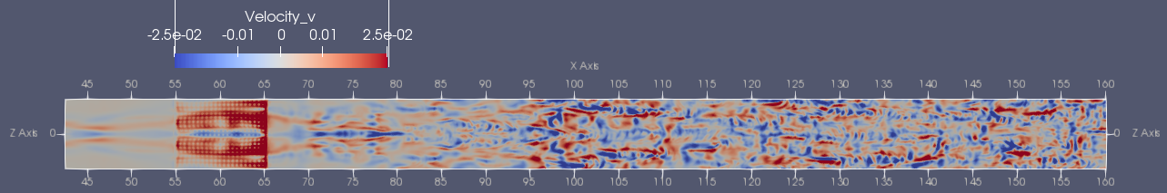
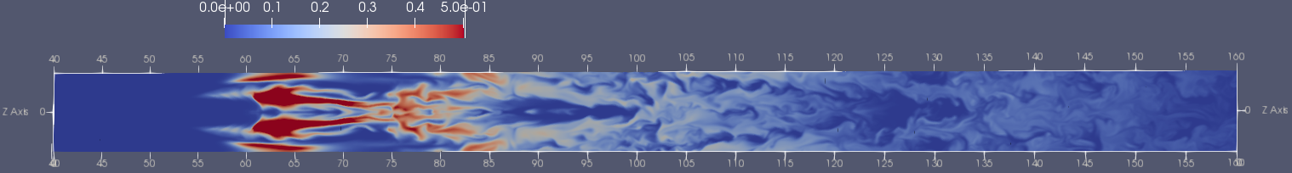
Oxford ultra-high temperature ceramics experiment
  M=5, Re=12.6E6 1/m from Herman et al. HiSST (2018)
  F_{porous}=0.002, porosity 42% modelled with spheres of diameter d=340μm
  p₀=1.3 p_{inf}, to match blowing ratio
  2000 x 300 x 100 mesh plus 2 levels refined factor 2
v-velocity: note specimen on left and transition to turbulence towards the right
Coolant concentration from top and side view
21

Slide 22
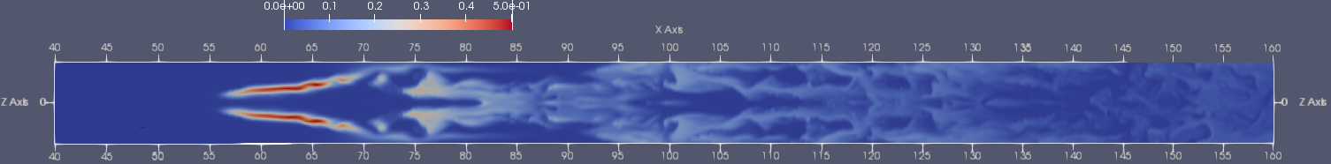
Comparison with suitable slot case
  Chose a slot case with comparable non-dimensional mass flow of injected coolant d=ρUA_{inj}
  F_{porous}=0.002, F_{slots} =0.045,
  d_{slots} = 0.173, d_{porous} = 0.144
  Cooling effectiveness (averaged spanwise and in time)
  Stanton number (averaged spanwise and in time)
22
(Cerminara, Deiterding, Sandham. Int. J. Heat Fluid Flow, 2020)

Slide 23
Conclusions
A hybrid 6th order multi-species WENO/CD method in the AMROC framework for DNS of hypersonic boundary layers with wall injection has been implemented
  Method is efficient, robust and runs well on large parallel systems
Have developed a novel mesoscopic model for flow through porous structures that can be used with accurate hypersonic boundary layer DNS, thereby avoiding resolving the O(1-2μm) structures of the manufactured material
Validation cases for both slot injection and porous injection have demonstrated a good agreement with available experimental results
Level of realism in order to model realistic flight conditions will be increased further by supplementing the implementation with
  Transient surface heat conduction modelling
  Thermochemical and vibrational nonequilibrium models
23

